Slide 1

Moving Average Trade Strategy
Simulation using Netlogo
By Aziz Isamedinov

Slide 2


Problem
Think about an investor in the stock market who buys stock that immediately goes up or down a little bit. Was buying the right decision? You don’t know the answer for years.
It’s the same with decision making generally. We don’t really know how things are going to unfold, so it’s difficult to make forecasts or budgets going many years into the future.
Lets use technical indicators that reveal historical average behavior of a stock price for a given time frame and develop a trading strategy. But what guarantees that the strategy will perform well in the future?

Slide 3

Solution: Back testing
What is it?
Definition: Back testing is a mathematical simulation used by traders to evaluate the performance of a trading strategy and maximize profit.
Tool: It is a back test simulation tool that can be run on any stock price using a strategy built with technical indicators(ie. SMA).
Why is it useful?
Traders/Analysts can simulate a trading strategy using historical data to generate results and analyze risk and profitability before risking any actual capital.
Select the most suitable instruments with a particular trading strategy and create an investment portfolio with optimized return.
The tool can also be used to fine-tune or improve strategies and develop an automated trading system

Slide 4
CAS: Environment, System & Networks
Environment:
Stock Market is highly competitive business environment in which companies operate, its behavior often changes as a result of the behavior of others i.e, businesses, sectors, politics or the whole economy. Therefore, It is very complex and open environment. Stock price is results of interactions among agents in that environment.
The System (Netlogo simulation tool):
Purpose: To evaluate the underlying strategy on historical stock prices and maximize profit.
Fitness function: Portfolio/Account Balance that changes based on the trade outcomes( profits/losses) is defined as a fitness function for this model, it can be optimized by tweaking indicator parameters or trade type.
System’s Intelligent Agents:
Short-SMA: It follows the average value of closing prices during the highlighted short-time period.
Long-SMA: It follows the average value of closing prices during the highlighted long-time period.
Trade Executor: It is a strategic decision making agent. It enters or exists the trade.(buy/sell).
Networks/relationships: Short & Long SMA agents are closely linked to the stock price. They adjust their behavior based on the price movement and Trade Executor makes decisions based on the agents behavior(not the price)

Slide 5
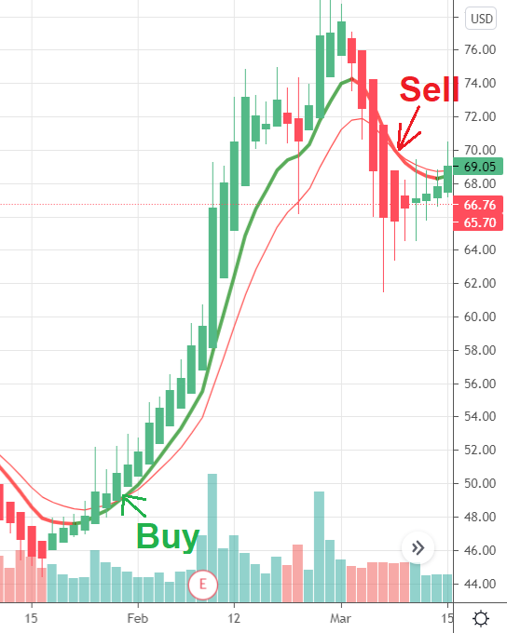

Strategy & System Flow
How it works in practice?
The Strategy applies two moving averages to a chart: one longer and one shorter. When the shorter-term MA crosses above the longer-term MA, it's a buy signal, as it indicates that the trend is shifting up. This is known as a "golden cross"
Meanwhile, when the shorter-term MA crosses below the longer-term MA, it's a sell signal, as it indicates that the trend is shifting down. This is known as a "dead/death cross."
Data Flow:

Slide 6
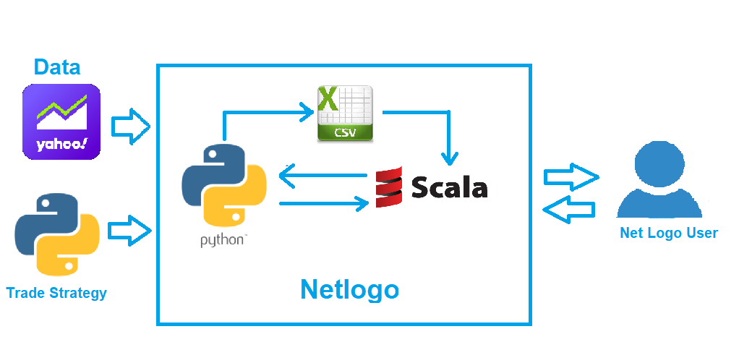
Netlogo: System Design & Code

Slide 7
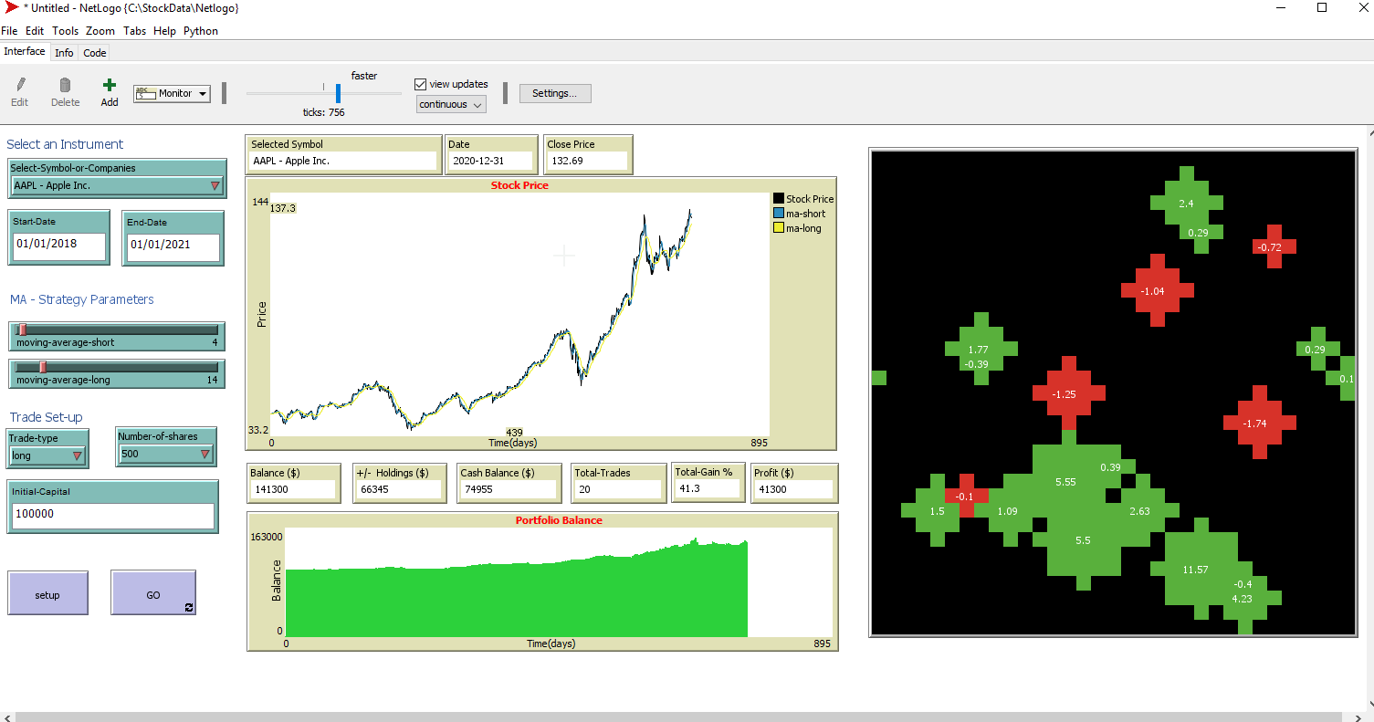
Application Overview

Slide 8
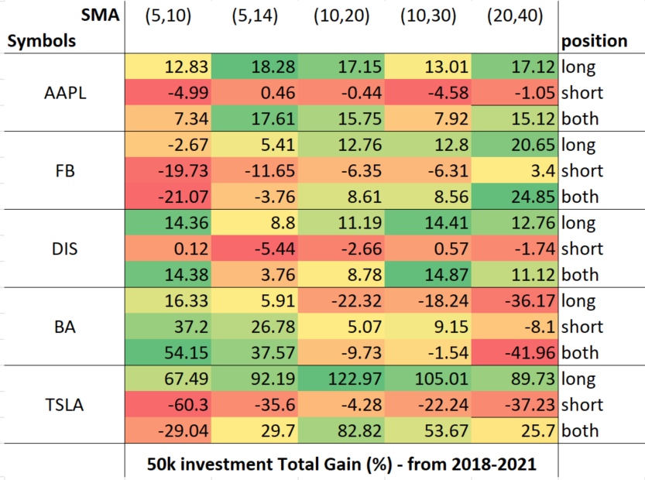
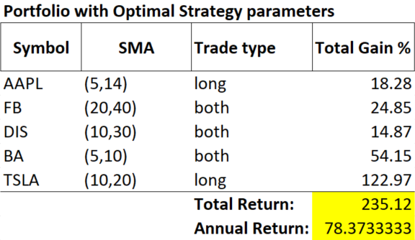
Model Results & Analysis & Conclusions
Results for optimal parameters & position type
Instrument List for Investment Portfolio

